Slide 1
Web Scraping and Word Frequency
Subtitle :- Using Requests, Beautiful Soup, and Text Processing
PREPARED BY Vicky Saini/31-01-2024

Slide 2
Introduction to Web Scraping
Definition of web scraping
Web scraping is the automated process of extracting data from websites. It involves using software tools or scripts to access and collect information from web pages in a structured format.
Importance of web scraping
The importance of web scraping stems from its ability to provide access to vast amounts of data on the internet efficiently and programmatically.

Slide 3
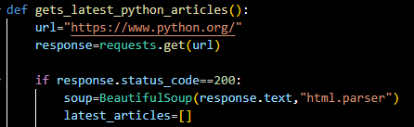
Python Libraries for Web Scraping
Requests library overview
BeautifulSoup library overview
Installation steps

Slide 4

Scraping Data from Python.org
Code snippet using Requests and BeautifulSoup
Retrieving data from python.org
Parsing HTML content

Slide 5
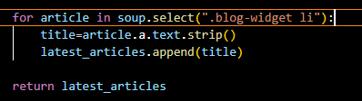
Understanding BeautifulSoup
Navigating the HTML structure
Extracting specific elements and attributes

Slide 6
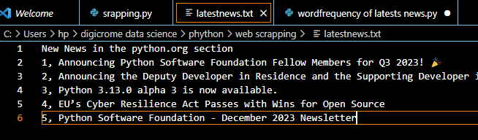
Saving Scraped Data to Text File
Writing scraped data to a text file
Demo:

Slide 7
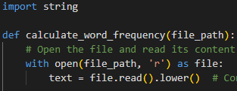
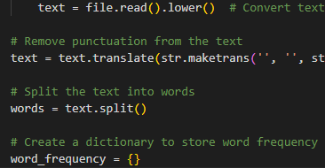
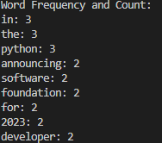
Creating a Program for Word Frequency Analysis
Reading text data from the previously created text file
Tokenizing the text into words
Counting the frequency of each word

Slide 8
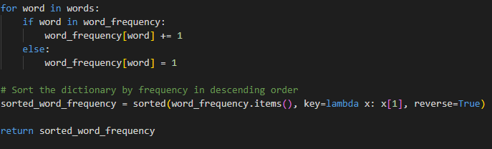
Word Frequency Analysis Program
Code walkthrough

Slide 9
Results and Conclusion
Learned how to use libraries like requests and BeautifulSoup to scrape data from websites and creating programs to analyse the scraped data for word frequency provides valuable skills and opens up numerous possibilities in the realm of data acquisition and analysis.
Through this learning journey, I have gained insight into the following key points:
Web Scraping Fundamentals, Data Retrieval and Parsing, Text Analysis Techniques, Practical Application.

